Slide 1
‘ GLOBAL VACCINE EQUITY AND ACCESS FATIMA HASSAN FEB 2021, ILRIG IMAGE CREDITS: PEOPLE’S VACCINE, FREE THE VACCINE, MSF, DAILY MAVERICK, FP, Kei, Lancet, public citizen, imak, bbc, duke, TWN

Slide 2
The People’s Vaccine
Everyone, everywhere, who needs it, must get a safe and effective vaccine
COVID-19 diagnostic tools, treatments, and vaccines must be available to everyone everywhere, free at the point-of-delivery
Peoples Vaccine - http://peoplesvaccine.org/
UAEM – Free the Vaccine https://freethevaccine.org/

Slide 4
February 2021 – in the middle of a pandemic – where are the vaccines?
Vaccine administration:
SA HCW – first study vaccine mid-February 2021 (Sisonke)
75% of vaccines administered in 10 rich countries- 130 countries – zero or handful of shots only administered
WHO – ‘moral catastrophe’
Dr Fauci, Vatican, AU, UNAIDS, Anglican Archbishop:
relax the patent regime, stop hoarding, share technology and urgently scale up for public health reasons too (widespread urgent global and esp. HVCW immunisation needed)

Slide 5
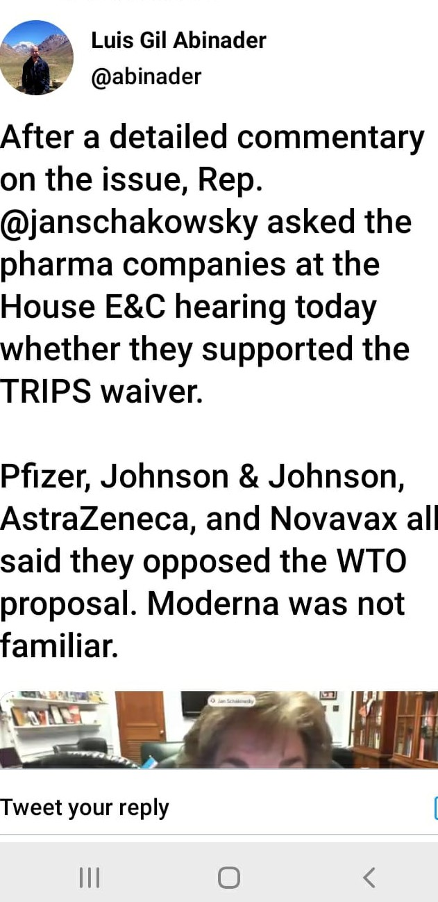
Vaccine Apartheid

Slide 6
“Phrma response…” US to USTO Annual via KEI

Slide 7
Ordinarily - Medicine System Pathway
Investment
Research
Patent
Regulatory
Suppliers
Delivery
Access
*With Covid-19 – compressed

Slide 8
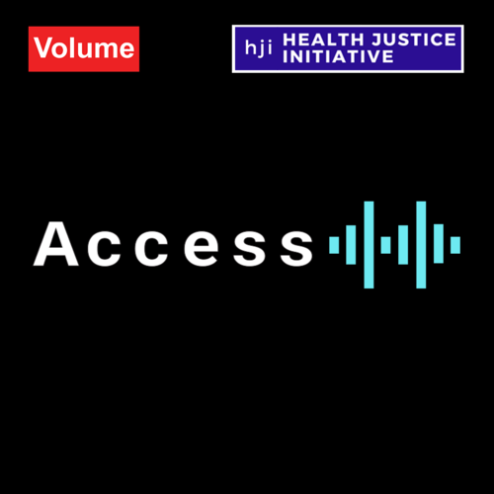
Understanding IP
HJI Podcast ACCESS:
Episode 1 Discusses Intellectual Property (IP) and focuses on Patents https://www.volume.africa/access
What is IP ?
Refers to creations of the mind, such as inventions; literary and artistic works; designs; and symbols, names and images used in commerce
IP is protected through patents, copyright and trademarks, which enable people to earn recognition or financial benefit from what they invent or create, to reward true innovation
A patent is an exclusive right granted for an invention and ‘provides the patent owner with the right to decide how - or whether - the invention can be used by others. In exchange for this right, the patent owner makes technical information about the invention publicly available in the published patent document’ (WIPO)
Trade secrets are IP rights on confidential information which may be sold or licensed. The unauthorized acquisition, use or disclosure of such secret information in a manner contrary to honest commercial practices by others is regarded as an unfair practice and a violation of the trade secret protection
Copyright is a legal term used to describe the rights that creators have over their literary and artistic works. Works covered by copyright range from books, music, paintings, sculpture and films, to computer programs, databases, advertisements, maps and technical drawings

Slide 9
How do patent monopolies work ?
Patent protection enables exclusive monopolies or oligopolies, limiting the number of companies that can make or distribute a generic equivalent
‘Data exclusivity’ is a backdoor way of preventing competition, so that even when a medicine is not protected by a patent, a pharmaceutical company will receive a minimum period of market monopoly when artificially high prices can be charged
Patent monopolies held by pharmaceutical corporations and a lack of price-lowering competition means that high drug prices can be charged for life-saving medicines, like they were / are for ARVs and cancer medicines

Slide 10
How does market exclusivity undermine health rights and medicine access ?

Slide 11
TRIPS as part of the WTO Rules
The Agreement on Trade-Related Aspects of Intellectual Property Rights (‘TRIPS Agreement’) sets the ‘standards’ for intellectual property protection in the world today, including patents, which governs medicines
1 January 1995
Binding on all members of the World Trade Organization (WTO)
Member states of the WTO (150 + countries) agree to certain common standards in the way they enact and implement their patent laws
Patents be given for a minimum of 20 years; given both for products and processes; and that pharmaceutical test data be protected against ‘unfair commercial use’
What ‘deserves’ to be patented is left for countries to determine
Implementation of the TRIPS Agreement’s intellectual property standards limits competition and local manufacturing, affecting access to medicines
2001, at the annual ministerial meeting of the WTO in Doha, countries agreed to redress that imbalance, the ‘Doha Declaration’ reaffirmed countries’ right to use TRIPS safeguards such as compulsory licenses or parallel importation to overcome patent barriers
The pressure to enact or implement even tougher or more restrictive measures and laws are known as ‘TRIPS plus’ provisions and bi-lateral trade pressure often influences countries adopting such negative measures
In SA- TRIPS plus provisions are yet to be remedied and the Fix Patents Law (FPL) Campaign is leading on this issue

Slide 12
‘TRIPS WAIVER’ Request
SA Government Submission to WTO: July 2020
‘TRIPS flexibilities are difficult to use, rarely invoked by Global South’
AU Communique on IP Barriers for Vaccine Access: July 2020
SA and Indian Government Joint Proposal for TRIPS Waiver : October 2020 –
India and South Africa on 2 October 2020 asked the World Trade Organization (WTO) to allow all countries to choose to neither grant nor enforce patents and other intellectual property (IP) related to COVID-19 drugs, vaccines, diagnostics and other technologies for the duration of the pandemic, until global herd immunity is achieved (not just for patents, but for trade secrets and copyrights, industrial design)
Now supported by many developing world countries
Opposed by Brazil, Australia, EU, UK, US, Canada, Japan – and handful of very rich nations who have commenced own vaccination programmes through AMCs and/or COVAX purchases too
While waiver request is important, again, limitations and domestic constraints, including local laws not being passed
See also: https://msfaccess.org/india-and-south-africa-proposal-wto-waiver-ip-protections-covid-19-related-medical-technologies

Slide 13
Access and blockers of access

Slide 15
Civil Society - Responses & Realities
Access cannot hinge on benevolence and charity OR no transparency
Billions in public investment including for accelerated vaccine research for Covid-19
Voluntary licenses are limited, even if helpful – segments markets – who has ultimate control and right to IP
COVAX has several serious limitations and limited transparency – ‘27% LIC coverage by end 2021’ should constitute a crisis point
Rich countries have pre-bought supplies via advanced purchase agreements (or AMCs), bi-laterally and via COVAX too
TRIPS flexibilities are difficult to use in practice in each domestic context (trade and other pressures, legal delays too)
Domestically in SA – fix the patent laws – Parliament has STILL not passed the law – not even in a pandemic
Safe manufacturing can be ramped up with proper investment and urgent data sharing

Slide 16
‘Vaccine Nationalism’
Vaccines and IP – More than just about patent monopolies and rights/claims – also:
Background technologies (platforms); Foreground technologies (vaccine products)
Manufacturing know how and clinical data (trade secrets)
Bi-lateral technology transfer and licensing
Recent Reports - Rich countries have bought up more than half the world’s supply (some more than 3 times needed, some more than 5 times needed)
COVAX limitations
Voluntary pooling mechanism; ‘Tiered pricing; Self-financing for MICs; Alongside bi-lateral agreements; Not all governments and companies entered voluntary pool; Own deadlines, no pricing transparency, no pricing data shared, unclear governance frameworks- GAVI ; Relies on charity for LICs – not yet raised full target; endorses IP regime
Phrma refuses to grant multiple and sustainable non-exclusive, reasonable terms, global licenses in a pandemic
African Governments not yet committed to compulsory licenses because hoping for access through waiver, donations, goodwill, bi-lateral agreements or COVAX and deference to volunteerism (explains TRIPS Waiver request)
WHO- C-TAP – also voluntary = no participation as yet

Slide 17
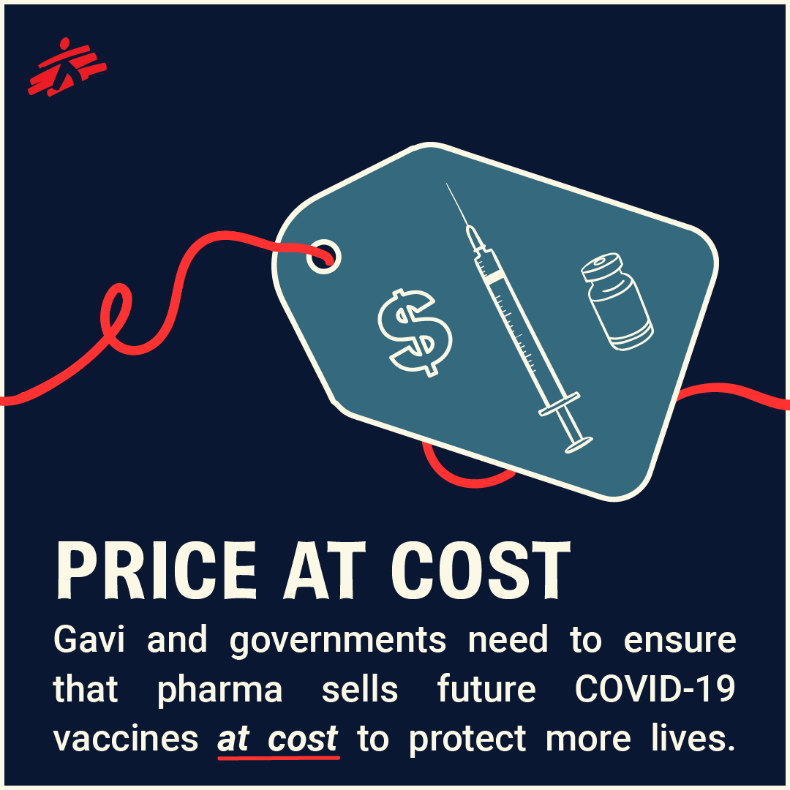
Calls
‘A People’s Vaccine’ / ‘Free the Vaccine’
Geography – everyone, everywhere
Stop Opposing the TRIPS Waiver – lives depend on it
Price at cost, not at profit, for a longer period
Transparency - Require drug companies, corporations as well as university research institutions to open their books and show the public all research & development and production costs – as domestic price regulation is hostage to NDAs/ confidentiality/ secrecy agreements and no-fault compensation schemes
Companies cannot unilaterally decide supplies, pricing and when pandemic ends
Community involvement – to encourage democratic participation, build community trust and avoid vaccine hesitancy as well as growing anti-vaccine movement
Share technology and treat as ‘global public good’

Slide 18
South Africa – impact locally
Vaccine Selection and Trials
Trial- AstraZeneca/Oxford Group (roll out paused early 2021)
Trial - Johnson and Johnson (Sisonke+ rolled out early 2021)
Aspen sub-license for fill and finish only
NO BIOVAC licenses – yet
Trial - Novavax (not in selection);
Trial - Pfizer/BioNtech (in selection)
Other discussions and negotiations pending with Moderna Inc (NIH-Moderna Vaccine), AU VATT, COVAX (AZ/Pfizer forecast)
See DG affidavit in Afriforum/Solidarity matter
Budget announcement includes NO FAULT COMPENSATION SCHEME (J$J)
GLOBALLY: Vaccine candidates received $ 10 billion of known public investment and philanthropic funding to accelerate vaccine research (low transparency)

Slide 19
THE LANCET: Challenges in ensuring global access to COVID-19 vaccines: production, affordability, allocation, and deployment Olivier J Wouters et al

Slide 20
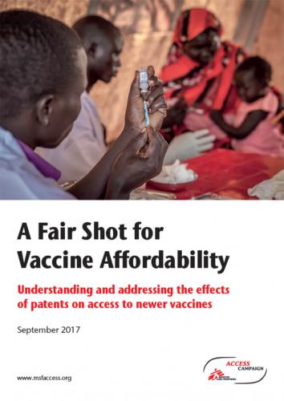
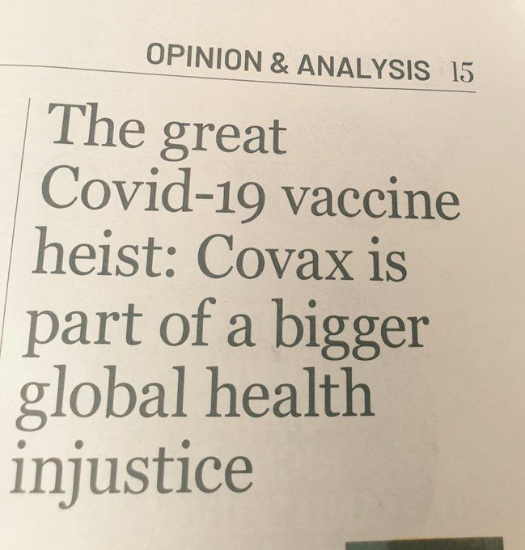
Reading Materials & Links
SA Government Submission to the WTO - July 2020
https://www.keionline.org/33551
SA Government Statement on TRIPS / WTO Negotiations (‘TRIPS Waiver’) and Submissions
https://www.keionline.org/34061
MSF TRIPS Waiver Briefing Document; MSF Report on Patents and Vaccines
https://msfaccess.org/fair-shot-vaccine-affordability
‘Whoever Finds the Vaccine Must Share It - Strengthening Human Rights and Transparency Around Covid-19 Vaccines’ – HRW
https://www.hrw.org/report/2020/10/29/whoever-finds-vaccine-must-share-it/strengthening-human-rights-and-transparency
‘9 out of 10 people in poor countries are set to miss out on COVID-19 vaccine next year’ –Amnesty International, Oxfam +
https://www.amnesty.org/en/latest/news/2020/12/campaigners-warn-that-9-out-of-10-people-in-poor-countries-are-set-to-miss-out-on-covid-19-vaccine-next-year/
The Great COVID-19 Vaccine Heist (Part 1 and Part 2)
https://www.dailymaverick.co.za/article/2020-12-06-the-great-covid-19-vaccine-heist/
Don’t let drug companies create a system of Vaccine Apartheid
https://foreignpolicy.com/2021/02/23/dont-let-drug-companies-create-a-system-of-vaccine-apartheid
Links:
https://genevahealthfiles.com/
https://www.keionline.org/
https://msfaccess.org/
https://www.healthjusticeinitiative.org.za/post/vaccine-equity-access-and-allocation

