Slide 1


Discussion on:
Scepticism/opposition to vaccines
Sources of widespread vaccine opposition
Dealing with opposition to vaccines

Slide 2
Key successes due to vaccination:
Eradication of smallpox
Eradication of polio types 1 & 3 strains
Control of morbidity & mortality associated with several VPDs- about 26 vaccines are currently in use

Slide 3
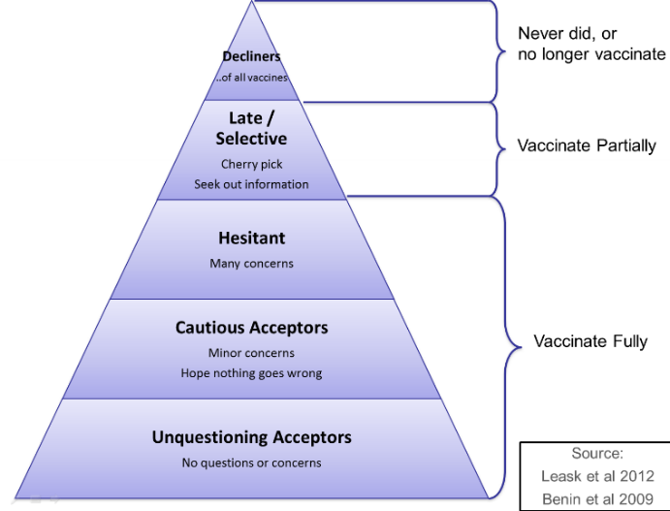
Slide taken from Prof. Wiysonge’s slides for AAVC2020

Slide 4
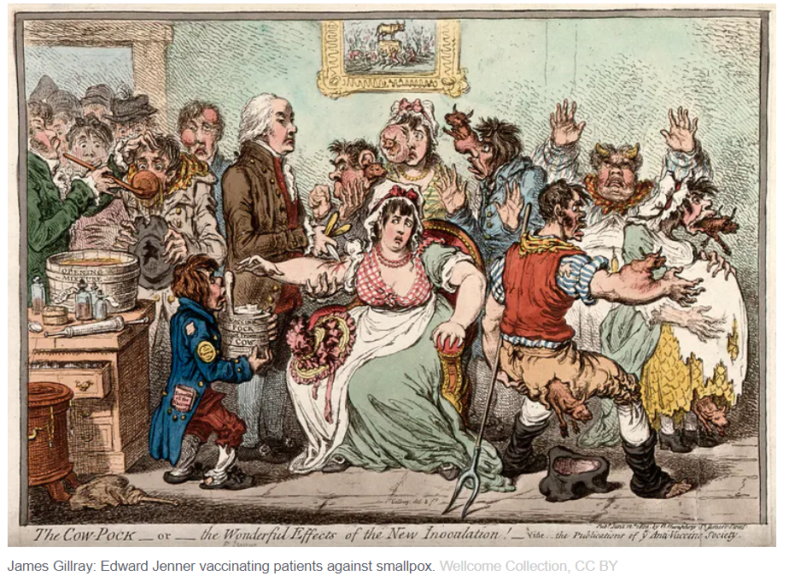

Slide 5
Vaccine safety as a key concern in general:
Vaccines are not 100% safe: mild adverse events are common
In rare cases, severe adverse events can occur

Slide 6
COVID-19 vaccines safety:
11 vaccines approved in several countries
All are safe
Shows expected mild adverse events
A rare SAE (anaphylaxis)occurred at a rate of 4.5 people per million (CDC, Feb 2021)
Notes:
a life-threatening but treatable allergic reaction that occurred

Slide 7
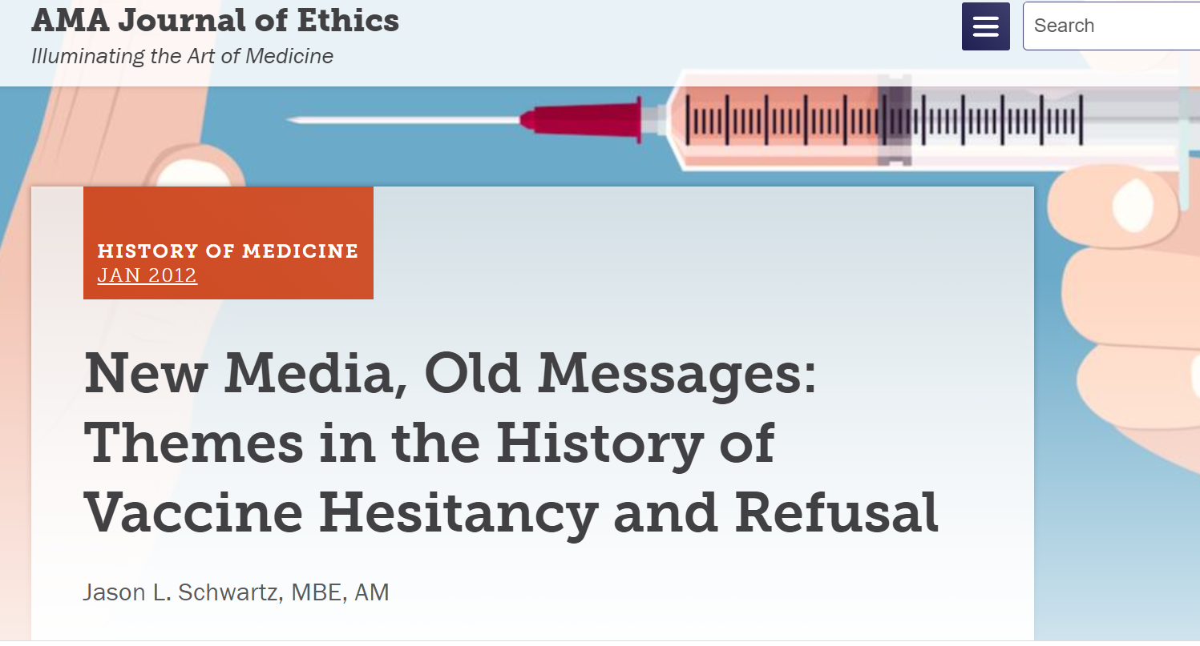
Notes:
The first theme is the perception among critics that vaccines, individually and collectively, cause more harm than the diseases that they are intended to prevent.
A second theme in this history is the close association between the promotion of vaccines and mandatory vaccination policies intended to ensure compliance.

Slide 8
Vaccine disinformation & vaccination coverage
Wilson SL, Wiysonge CS. BMJ Global Health 2020
Notes:
We recently used a large cross-country regression framework to evaluate the effect of social media on vaccine hesitancy globally.
We also found that foreign disinformation campaigns online are associated with both a drop in vaccination coverage over time and an increase in negative discussion of vaccines on social media.

Slide 10
Reasons for vaccine hesitancy:
Diverse
Complex
Sensitive to social and political context
Can vary with time

